Slide 1
THE ALL INDIA HINDU MAHASABHA AND THE RSS
SEM-IV,CC-X
DEBABRATA NANDI

Slide 2
HINDU MAHASABHA
The Hindu Mahasabha (officially Akhil Bhārat Hindū Mahāsabhā or All-India Hindu Grand-Assembly) is a right wing Hindu nationalist political party in India.
The organisation was formed to protect the rights of the Hindu community in British India, after the formation of the All India Muslim League in 1906^{[3]} and the British India government's creation of separate Muslim electorate under the Morley-Minto reforms of 1909.
Although quite an old Hindu nationalist political party, the Hindu Mahasabha has remained marginal in its influence on Indian politics, both before and after independence.

Slide 3
Preparatory sessions of the All India Hindu Sabha were held at Haridwar (13 February 1915), Lucknow (17 February 1915) and Delhi (27 February 1915). In April 1915, Sarvadeshak (All India) Hindu Sabha was formed as an umbrella organisation of regional Hindu Sabhas, at the Kumbh Mela in Haridwar. Gandhi and Swami Shraddhanand were also present at the conference, and were supportive of the formation of All India Hindu Sabha. The Sabha laid emphasis on Hindu solidarity and the need for social reform.

Slide 4
Amongst the Mahasabha's early leaders was the prominent nationalist and educationalist Pandit Madan Mohan Malaviya, who founded the Benaras Hindu University, and the Punjabi populist Lala Lajpat Rai. Under Malaviya, the Mahasabha campaigned for Hindu political unity, for the education and economic development of Hindus as well as for the conversion of Muslims to Hinduism

Slide 5
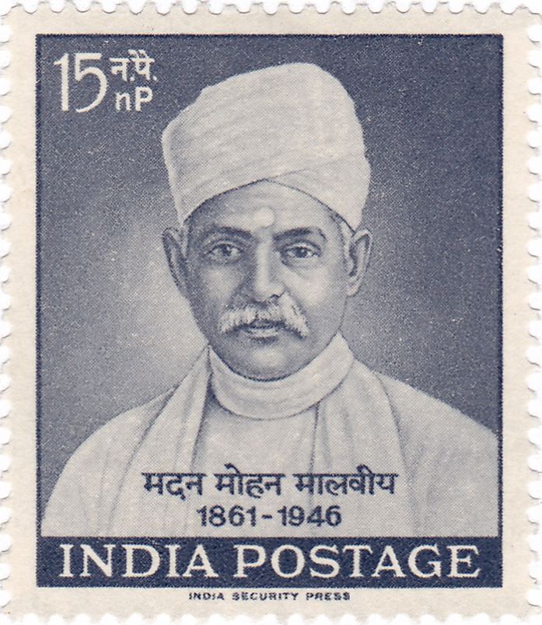

Slide 6
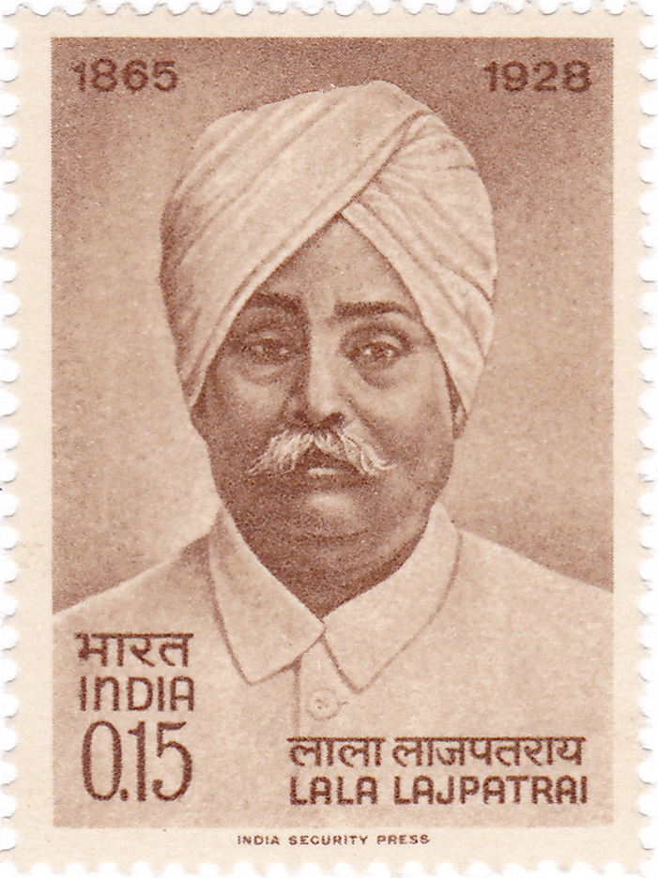

Slide 7
In the late 1920s, the Mahasabha came under the influence of leaders like Balakrishna Shivram Moonje and Vinayak Damodar Savarkar. Savarkar was a former revolutionary who had been banned from anti-British political activities and opposed the secularism of the Congress. Under Savarkar, the Mahasabha became a more intense critic of the Congress and its policy of wooing Muslim support. The Mahasabha suffered a setback when in 1925, its former member Keshav Baliram Hedgewar left to form the Rashtriya Swayamsevak Sangh, a Hindu volunteer organisation that abstained from active politics. Although ideologically similar to the Mahasabha, the RSS grew faster across the nation and became a competitor for the core constituency of the Mahasabha.

Slide 8
Vinayak Damodar Savarkar

Slide 9
RSS(Rashtriya Swayamsevak Sangh)
Rashtriya Swayamsevak Sangh, abbreviated as RSS (Rāṣṭrīya Svayamsēvaka Saṅgha, "National Patriotic Organisation), is an Indian right-wing, Hindu nationalist, paramilitary volunteer organisation that is widely regarded as the parent organisation of the ruling party of India, the Bharatiya Janata Party. The RSS is one of the principal organizations of the Sangh Parivar group. Founded on 27 September 1925, by Keshav Baliram Hedgewar. it claimed a commitment to selfless service to India. The organisation is the world's largest voluntary missionary organization.

Slide 10
Keshav Baliram Hedgewar

Slide 11
THANK YOU

